Slide 1
Using AI to Aid in World Building
Brad Harris, SimCentral.org

Slide 2
Introduction

Slide 3
“Computer, create a mystery in the Holmesian style…”
- Geordi La Forge

Slide 4
Agenda
World Building Challenges
AI Defined
The ChatGPT Tool
World Building With AI Demo
ChatGPT Tips and Tricks
Q&A
Conclusion

Slide 5
World Building Challenges

Slide 6
What challenges have you faced when world building for your game/fiction?

Slide 7
AI Defined

Slide 8
“The ability of a digital computer or computer-controlled robot to perform tasks commonly associated with intelligent beings.”
- Encyclopedia Britannica

Slide 9
The ChatGPT Tool

Slide 10
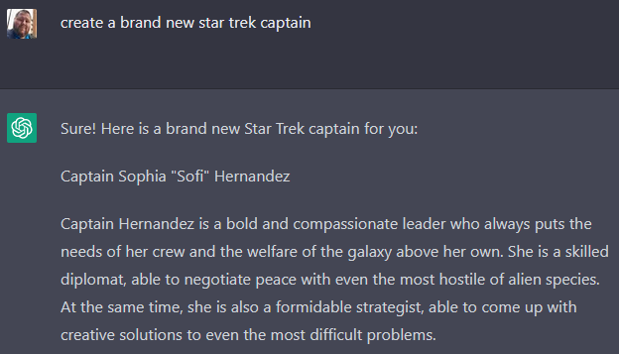
The ChatGPT Tool
Uses “conversational” prompts to generate output.
Accepts follow-up requests for edits or additional details.
Remembers all previous sessions so you can revisit them as needed.
https://chat.openai.com/chat

Slide 11
AI World Building Demo

Slide 12
ChatGPT

Slide 13
ChatGPT Tips and Tricks
Remember that ChatGPT is in beta. This means that you may encounter bugs or other hiccups. The tool is also subject to change with iterative updates.
Make initial and follow-up requests as specific as possible. The vaguer your request, the more “off” the output will be.
Use the word “fictional” in your requests. This tells the AI it’s ok to “dream up” new ideas without violating existing IP copyright.
Use the word “original” when requesting ideas for new planets, ships, characters, etc. This helps the AI to create brand new ideas vs. pulling from pre-existing canon.
Don’t be afraid to ask for edits or rewrites as needed.
While the tool does save previous sessions or “chats,” save anything you need locally just in case.
Because the tool is free, the system does sometimes limit how many requests you can make per hour. If this happens, simply wait a bit and try again later.

Slide 14
Q&A

Slide 15
Thank You
Brad Harris
Brad@simcentral.org
http://www.simcentral.org
https://discord.gg/simcentral

